Slide 1
Union pension fund Withdrawal Liability in the Construction Industry
Michigan Association of Certified Public Accountants Annual Conference
How to Identify Risk and Protect Your Client
Sullivan and Leavitt, P.C., Novi, MI

Slide 2
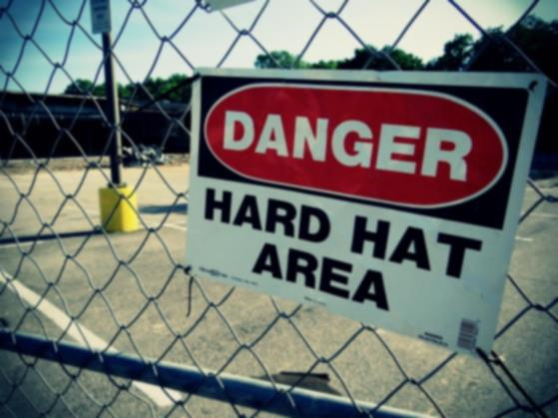
Overview and Explanation of Withdrawal Liability
Employee Retirement Income Security Act of 1974 (“ERISA”)
Multi-Employer Pension Plan Protection Act Amendment (“MPPAA”)
The Liability is Essentially an “Exit Fee” From the Pension Fund
The Liability is Applied Without Regard
to Employer Fault
The Amount of the Liability can
be Extensive
Sullivan and Leavitt, P.C., Novi

Slide 3
TYPES OF WITHDRAWAL
Complete Withdrawal – a “complete withdrawal” occurs when an employer (1) permanently ceases to have an obligation to the plan; or (2) permanently ceases all covered operations under the plan.
Partial Withdrawal
A decline of 70 percent or more in the employer’s “contribution base units” for a period of three consecutive years or
A partial cessation of the employer’s obligation to contribute.
There also can be a series of partial withdrawals, the financial effect of which can be more severe than a complete withdrawal.
Sullivan and Leavitt, P.C., Novi

Slide 4
EXAMPLES OF EVENTS THAT CAN TRIGGER A WITHDRAWAL
Sale or closure of a business
Substantially downsizing a business
Going non-union
Pension fund negotiated out as a benefit
Union decertification by employees (even if going to a new union)
Michigan Right-to-Work laws
Adverse Selection
Sullivan and Leavitt, P.C., Novi

Slide 5
POTENTIAL EXEMPTIONS TO THE IMPOSITION OF WITHDRAWAL LIABILITY
Construction Industry Exemption
Trucking Industry Exemption
“Sale of Assets”
De Minimis Rule
Sullivan and Leavitt, P.C., Novi

Slide 6
Construction Industry Exemption (slide 1)
Why is there a Construction Industry Exemption?
Factors Required to Receive the Benefit of Exemption – Complete Withdrawal:
“Substantially all” of the employees for whom the employer has an obligation to contribute perform work in the building and construction industry, and either
The plan covers primarily employees in the building and construction industry; or
The Plan has been amended to provide that the rules apply to employers with an obligation to contribute for work performed in the building and construction industry (it is important to be familiar with the Pension Plan Trust Agreement before a withdrawal occurs to determine whether the Plan has adopted this amendment.)
Sullivan and Leavitt, P.C., Novi

Slide 7
Construction Industry Exemption (slide 2)
“Substantially All” Standard: The phrase “substantially all” is not defined in ERISA or MPPAA and the courts have differed in part on what test to apply. This is a fact intensive area of inquiry that should not be pursued on a casual basis.
What is the “construction industry”: The phrase “construction industry” is also not defined in ERISA or MPPAA and also requires an intense factual analysis to determine whether the standard is met.
Limitation on exemption when contributing to multiple plans –May apply to one but not another.
Factor Required to Receive the Benefit of Exemption – Partial Withdrawal
The Employer has not shifted its work mix in the jurisdiction so that only an insubstantial part of such work in the jurisdiction is covered.
Sullivan and Leavitt, P.C., Novi

Slide 8
Factors that Void the Exemption
The employer continues to perform the same or similar work (i.e., work of the type for which contributions were previously required) in the jurisdiction of the collective bargaining agreement;
The employer resumes such work within five years after the cessation of the obligation to contribute, and does not renew the obligation at the time of the resumption.
Sullivan and Leavitt, P.C., Novi

Slide 9
If withdrawal liability is imposed, who has to pay it?
CONTROL GROUP
“Common control” – determined under IRS Regulations w/attribution
“Trade or business” – must be regular and continuous and performed with a profit motive, even if not profitable. Courts have relied solely on the stated business purpose in formation documents. Examples include:
All rental activity where the tenant is the withdrawn employer
Ownership of a vacation property that is rented to third parties
Rental of a home while efforts are being made to sell same.
Hobby activity like collecting coins or stamps if they are resold for profit.
Consulting activity where the individual has independent contractor status.
Rental activity involving investment real estate properties if there is found to the required degree of activities by the owner.
Partners and parties to joint ventures are also jointly and severally liable for the withdrawal liability.
Alter-Ego. Federal Common Law test under Labor Law criteria
Successor in Interest. (Application of Federal Common Law).
Sullivan and Leavitt, P.C., Novi

Slide 10
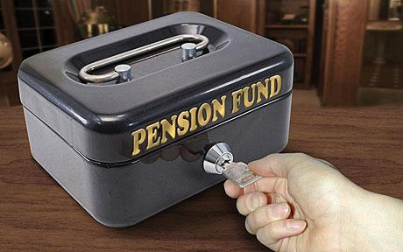
How Withdrawal Liability is paid
Payments begin within 60 days after the pension plan’s demand for payment.
Installment payments are limited to a 20-year period
The Pension Fund may demand payment in full if there is a default in the installment plan that is not
cured, or if the pension fund feels
“insecure”.
Sullivan and Leavitt, P.C., Novi

Slide 11
Effect of Failure to Pay
60 days to cure
20% liquidated damages
Actual attorney fees
The default operates against all members of the control group
Sullivan and Leavitt, P.C., Novi

Slide 12
Actions to Evade or Avoid Withdrawal Liability
If it is found that a principal purpose of any transaction by a withdrawing employer is to evade or avoid liability under MPPAA, the Act shall be applied, the transaction will be set aside, and the transactional proceeds will be collected by the fund without regard to such transaction. The types of transactions that are typically scrutinized include:
The sale of a business.
Grant of a security interest to secure pre-existing shareholder loans.
Distributions to shareholders when the prospects of a withdrawal are foreseeable.
Transfer of assets to a corporate retirement trust.
Incorporation of an unincorporated entity on the eve of a withdrawal.
Transfers of stock on the eve of a withdrawal to avoid the control group minimum-ownership standards.
Sullivan and Leavitt, P.C., Novi

Slide 13
Right to Obtain Estimate of Withdrawal Liability
Automatic right to request
Could be used as proof of an intent to evade or avoid.
Sullivan and Leavitt, P.C., Novi

Slide 14
Reporting requirements on Annual Financial Statements
The plan's employer identification number and, if available, its three-digit plan number.
The legal name of the pension plan.
Pension Protection Act certified "zone" status provided by the plan.
The expiration dates of each collective bargaining agreement.
For each period that a statement of income or statement of activities is presented, (i) the employer's contributions made to the plan and (ii) whether those contributions represent more than 5% of total contributions to the plan as indicated in the plan's most recently available annual report (IRS Form 5500 for U.S. plans).
As of the end of the most recent annual period presented, (i) whether a "funding improvement plan" or "rehabilitation plan," as defined in ERISA, had been implemented or was pending; (ii) whether the employer paid a surcharge to the plan; (iii) a description of any minimum contribution required for future periods by each CBA as well as by statutory obligations or other contractual obligations, if applicable.
Sullivan and Leavitt, P.C., Novi

Slide 15
Importance of Contingent Withdrawal Liability for Employer who is Still Contributing to a Multi-Employer Pension Fund
Valuation of a marital estate for divorce purposes.
Valuation of shares of a company for shareholder buy-out.
Valuation of shares of a company for estate planning purposes.
Valuation of a company for acquisition purposes.
Determination of the credit-worthiness of a company for credit or bonding purposes.
Valuation of shareholder net worth.
Sullivan and Leavitt, P.C., Novi

Slide 16
What to Look for on Tax Returns to Highlight Potential Risk Factors for your Clients
The shareholders’ or members’ individual Schedule K-1’s may identify unrelated companies that could be under common control with the contributing employer.
Basis of income reported on Schedule C.
Schedule E of a shareholder’s or member’s Form 1040 re: commonly controlled trades or businesses.
Reporting of “investment” income as income earned in the operation of a “trade or business.”
Unsecured shareholder loans from the shareholder to the corporation.
Sullivan and Leavitt, P.C., Novi

Slide 17
AVOIDABLE EVENTS THAT CAN IMPOSE LIABILITY AGAINST PARTIES OTHER THAN THE WITHDRAWING EMPLOYER
Leasing real estate to the withdrawing employer.
A shareholder holding at least 80% of the stock of a withdrawn employer (applying rules of attribution) engaging in any “trade or business” in an individual capacity rather than through a corporation or LLC.
A group of shareholders holding at least 80% of the stock of a withdrawn employer (applying rules of attribution) engaging in any “trade or business” as a partnership.
A shareholder holding at least 80% of the stock of a withdrawn employer (applying rules of attribution) being paid and/or treated as an independent contractor.
An entity not under common control with the withdrawing employer, but owned by members of the same family, sharing employees, facilities, worker’s compensation policies or other indicia of “joint employer” or “alter ego” status.
Expanding the scope of operations of a construction industry employer that would otherwise fit within the construction industry exception to include non-construction industry services.
Triggering a withdrawal prior to an anticipated sale of substantially all of the withdrawing employer’s assets to an unrelated third party resulting in the loss of the statutory limitation on withdrawal liability.
Failure to timely and properly secure loans from a majority shareholder to the withdrawing employer resulting in the loss of a priority creditor position.
Sullivan and Leavitt, P.C., Novi

Slide 18
CONCLUSION – As it Relates to Clients who Contribute to Multi-Employer Pension Funds
Review tax returns to identify risk factors
Need strategic planning for any contributing employer who is considering or facing a withdrawal
Always consider the contingent risk of withdrawal liability for valuation purposes
Always advise clients not to engage in a trade or business in a partnership or in their individual capacity.
Sullivan and Leavitt, P.C., Novi

Slide 19
For more information, contact us at:
248-349-3980
Sullivan and Leavitt, P.C., Novi, Michigan

